Slide 1
Student Register App
A Mobile App for Registering and Viewing Student Data
Flutter Mobile App Project
By: Arjit Rawat and Aarpit Kumar Roul

Slide 2
Objective
• To build a simple and clean mobile app for student registration.
• Allow users to input and submit their personal information.
• Provide functionality to view all registered students.

Slide 3
Key Features
• Form input for Name, Contact Number, Email, DOB, Gender.
• Validation for correct input formats (e.g., email, phone).
• Registration via HTTP POST to PHP backend.
• Display list of registered students with details.

Slide 4
Tools & Technologies
• Flutter and Dart for front-end UI development.
• HTTP package for backend communication.
• PHP and MySQL for backend API and database.
• Local server setup using XAMPP or WAMP.

Slide 5
Code Highlights
• Form validation using regex and input formatters.
• Use of state management for dropdowns and date selection.
• HTTP calls using `http.post` and `http.get`.
• ListView builder for displaying student list dynamically.

Slide 6
Challenges & Solutions
• Issue: Flutter app not connecting to localhost.
• Solution: Use system IP instead of 127.0.0.1.
• Issue: Date and dropdown input complexity.
• Solution: Use native date pickers and dropdown form fields.

Slide 7
Learning Outcomes
• Improved understanding of Flutter widgets and UI.
• Experience in handling backend APIs from mobile.
• Skills in debugging network issues and form input.
• Ability to design clean, usable mobile forms.

Slide 8
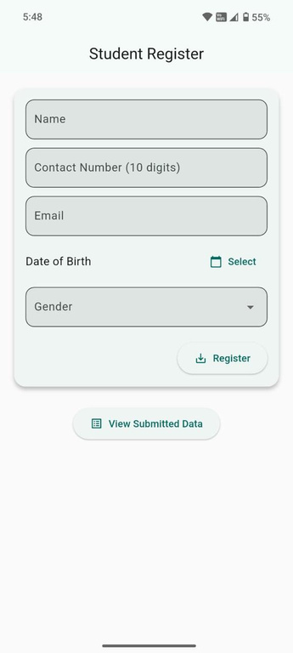
App Interface Screenshot

